Slide 1
Department of Computer Engineering
Subject:- Theory of Computation Unit 6
p

Slide 2
Tractable
and
Intractable
UNIT -VI

Slide 3
Tractability of a problem
 Tractability of a problem refers to difficulty level of a
problem. Difficulty in terms of amount of time it
takes to solve that problem.
 Tractability is related with the time complexity of a
solution algorithm.

Slide 4
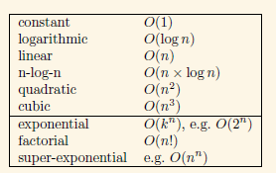
Some common functions, ordered by how fast
they grow.

Slide 5
Continue..
 Polynomial functions: Any function that is O(n^{k}),
for some constant k.
○ E.g. O(1), O(log n), O(n), O(n × log n), O(n²), O(n³)
 Exponential functions: The remaining functions.
○ E.g. O(2^{n}), O(n!), O(n^{n})

Slide 6
Tractable
 Problems that can be solved in reasonable time called
Tractable. OR
 A problem that is solvable by a polynomial-time algorithm.
 Here are examples of tractable problems (ones with known
polynomial-time algorithms):
1. Searching an unordered list
2. Searching an ordered list
3. Sorting a list
4. Multiplication of integers
5. Finding a minimum spanning tree in a graph

Slide 7
Intractable
1. Problems that “can be” solved but the amount of time it
takes to solve is too large.
2. A problem that cannot be solved by a polynomial-time
algorithm.
3. Can be solved in reasonable time only for small inputs.
Or, can not be solved at all.
4. As their input grows large, we are unable to solve them in
reasonable time.
o Eg: TSP

Slide 8
Classification of Problems
 Can be classified in various categories based on their degree
of difficulty, e.g.,
○ P
○ NP
○ NP-complete
○ NP-hard

Slide 9
Class P Problems
 P is the set of all decision problems solvable by deterministic algorithms in polynomial time.
 Polynomial time algorithms
o Decision problem
o Deterministic algorithm
o Sequential execution, no parallel processing
 E.g. Binary tree search –
o Time complexity O(log n)
o Only one node comparison at a time
o No parallel comparisons

Slide 10
Class NP
 Non deterministically polynomial(NP) time
algorithms
○ Decision problems
○ Nondeterministic algorithm
○ Parallel computations
○ Polynomial time complexity
○ E.g. travelling salesman problem,O(n² 2^{n})

Slide 11
Class NP
 NP is the set of all decision problems solvable by
nondeterministic algorithms in polynomial time.
OR
 Set of all problems which can be solved by a non-
deterministic Turing machine in polynomial time.
OR
 The problems whose solution can be verified in
polynomial time on a deterministic machine.
○ If we are given a certificate of a solution, we can verify that the certificate is correct in polynomial time in the size of input to the problem(eg TSP )

Slide 12
Continue..
 Nondeterministic algorithms: are allowed to
contain operations whose outcomes are limited to a
given set of possibilities instead of being uniquely
defined.
 Machine capable of executing a nondeterministic
algorithm is called a nondeterministic machine

Slide 13
Relation between P and NP Problems
 An unsolved problem in computer science is: Is P = NP or is P ⊆ NP?
P
NP
Any problem that can be solved by deterministic m/c
in polynomial time can also be solved by non-
deterministic m/c in polynomial time.

Slide 14
Some NP Complete Problems
○ Graph Coloring
○ TSP
○ Bin Packing
○ Knapsack
○ Subset Sum
○ Minesweeper Constraints
○ Many More

Slide 15
Polynomial Time Problems
E X A M P L E S

Slide 16
Minimum Spanning Tree
 Undirected weighted graph,G = (V, E)
○ V: set of vertices
○ E:set of edges
○ w(u,v):weight of edge connecting vertices u and v
 Objective:
○ Find acyclic subset of edges that covers all vertices and whose
total weight is minimized
○ Known as Minimum Spanning Tree (MST)
○ Total weight, W= ∑ of weights of all edges belonging to MST

Slide 17
Application (MST)
 Example:
○ Designing an electronic circuit with a set of‘n’ pins and wires
○ Objective: Connecting all the ‘n’pins
○ Minimum wires required: n–1
 Aim: To choose the best circuit among all
possibilities that incurs minimum expenses if wires
are of different costs

Slide 18
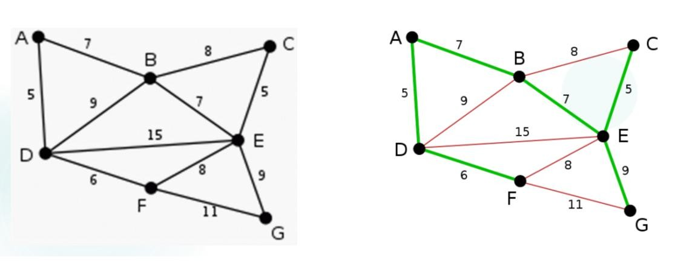
(example) Graph ‘G’ and its MST ‘T’

Slide 19
Kruskal’s Algorithm
 Finds a minimum spanning tree ‘T’ for a connected
weighted graph ‘G’
 E:Set of all edges in G in sorted order of their weights
 Time Complexity :O(E log E)
 While (T has less than ‘n –1’ edges) && E is not
empty
1. Choose an edge (v, w) from E of lowest cost
2. Delete (v,w) from E
3. Add(v, w)to T, if it doesn’t create a cycle
4. Else discard(v, w)

Slide 20
Manchester
40
30
Liverpool
Sheffield
110
70
40
Shrewsbury
80
50
50
Nottingham
B/ham
Aberystwyth
110
70
100
120
90
50
Bristol
Oxford
Cardiff
80
70
Southampton

Slide 21
NP
Problems
E X A M P L E

Slide 22
Travelling Salesman Problem
 Task: Given a list of cities and the distances between
each pair of cities, what is the shortest possible route
that visits each city exactly once and returns to the
origin city?
 It is an NP problem
 Problem:
○ Undirected weighted graph, such that cities are the graph's
vertices, paths are the graph's edges, and a path's distance is
the edge's length.
○ It is a minimization problem starting and finishing at a
specified vertex after having visited each vertex exactly once.

Slide 23
Continue..
 The original formulation:
○ Instance: A weighted graph G
○ Question: Find a minimum-weight Cycle in G.
 The yes-no formulation:
○ Instance: A weighted graph G and a real number d
○ Question: Does G have a Hamiltonian cycle of weight <=
d?

Slide 24
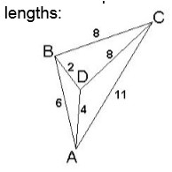
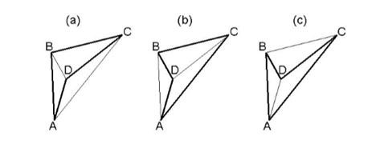
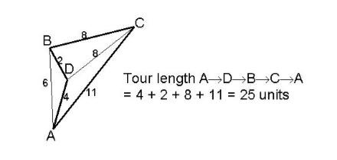
Example

Slide 25
Continue..
 It is not difficult to find solution to TSP in a small
graph like this but as the size of the graph grows the
time-demand appears to scale very badly and it is
strongly believed that there are no polynomial time
algorithms for this problem.
 there is no algorithms which solve this problem in
polynomial time.

Slide 26
NP complete
 NP-complete problems are the hardest problems in NP set.
 Definition: A problem B is NP-complete if:
(1) B ∈ NP
(2) A ≤_{p} B for all A ∈ NP
 If B satisfies only property (2) we say that B is NP-hard
 An equivalent but casual definition: A problem R is NP-
complete if R is the "most difficult" of all NP problems.

Slide 27
Reductions
 Reduction is a way of saying that one problem is
“easier” than another.
 We say that problem A is easier than problem B,
(i.e., we write “A ≤ B”)
if we can solve A using the algorithm that solves B.
 Idea: transform the inputs of A to inputs of B
_{yes} yes
_{no} no
Problem A
f ^{β} Problem B
α

Slide 28
Implications of Reduction
α
yes
no
Problem A
yes
no
f
β
Problem B
- If A ≤_{p} B and B ∈ P, then A ∈ P
- if A ≤_{p} B and A ∉ P, then B ∉ P

Slide 29
Importance
 Learning reduction in general is very important.
 For example, if we have library functions to solve certain
problem and if we can reduce a new problem to one of
the solved problems, we save a lot of time.
 Consider the example of a problem where we have to find
minimum product path in a given directed graph where
product of path is multiplication of weights of edges
along the path. If we have code for Dijkstra’s algorithm to
find shortest path, we can take log of all weights and use
Dijkstra’s algorithm to find the minimum product path
rather than writing a fresh code for this new problem.

Slide 30
Proving NP-Completeness In Practice
 Prove that the problem B is in NP
○ A randomly generated string can be checked in polynomial
time to determine if it represents a solution
 Show that one known NP-Complete problem can
be transformed to B in polynomial time
○ No need to check that all NP-Complete problems are reducible
to B

Slide 31
First NP complete problem?
 There must be some first NP-Complete problem
proved by definition of NP-Complete problems.
 SAT (Boolean satisfiability Problem) is the first NP-
Complete problem proved by Cook.
 That is, any problem in NP can be reduced in
polynomial time by a deterministic TM to the
problem of determining whether a Boolean formula
is satisfiable.

Slide 32
NP –complete
Problems
Satisfiablity
E X A M P L E

Slide 33
1.Satisfiability (SAT) problem
 Determining: If there exists an interpretation that
satisfies a given Boolean formula.
 Determining: If the variables of a given Boolean
formula can be assigned in such a way that the
formula evaluates to TRUE.
 If no such assignments exist, the function expressed
by the formula is identically FALSE for all possible
variable assignments.
 In this latter case, it is called unsatisfiable, otherwise
satisfiable.

Slide 34
Example:
 Consider the Boolean expression: “a AND NOT b”
○ Let, a=TRUE and b=FALSE
○ Expression becomes(a AND NOT b)=TRUE
○ Hence it is satisfiable.
 Consider the Boolean expression: "a AND NOT a"
○ Let, a=TRUE, the expression becomes FALSE
○ Let, a=FALSE, the expression becomes FALSE
○ Hence it is unsatisfiable

Slide 35
Normal Forms of Boolean Expressions
 Disjunctive normal form:(DNF)
if a boolean expression can be expressed as the sum
(OR) of products (AND).
 This can be written as:
○ A1 OR A2 OR A3 OR...An
○ Where each Ai is expressed as T1 AND T2 AND......AND Tm
○ where each Ti is either a simple variable, or the negation
(NOT) of a simple variable.
○ Each of the terms Ai is called a minterm.

Slide 36
CNF
 Conjunctive Normal Form: if a boolean
expression can be expressed as the product (AND) of
sums (OR).
 This can be written as:
○ O1 AND O2 AND O3 AND ...On
○ where each Oi is expressed as T1 OR T2 OR...OR Tm
○ where each Ti is either a simple variable, or the negation
(NOT) of a simple variable.
○ Each of the terms Oi is called a max term.

Slide 37
Continue..
 It is difficult to prove NP completeness of any NP
problem
 Convert every NP problem ‘P’ to satisfiability
problem to prove it is NP complete .
 NP Complete problems
○ Travelling Salesman Problem
○ Node cover problem
○ Hamiltonian Circuit problem
○ CSAT: Is a boolean expression in CNF satisfiable

Slide 38
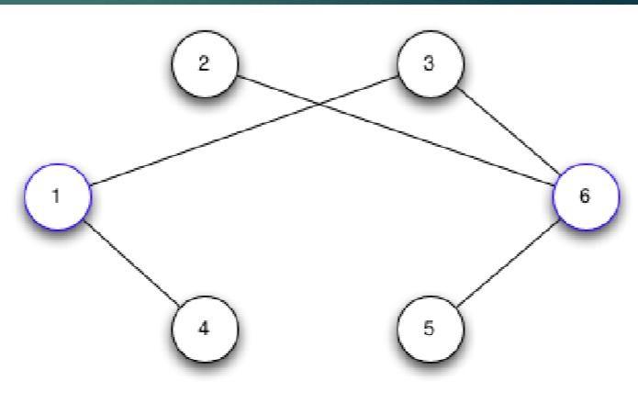
2.Node cover Decision Problem
 It is a subset of vertices that touch all the edges in an
undirected graph
 Node cover for this graph is:{1,6}
 which has size 6 - 4
= 2.

Slide 39
Continue..
 If node cover C of graph G with ‘n’ vertices has no removable vertices from C then the minimum node cover is C.
 Else, for each removable vertex v of C, find the number ρ(C−{v}) of removable vertices of the vertex cover C−{v}.
 Repeat until the vertex cover has no removable
vertices.
 Time complexity =O(n⁵)
 This problem can be proven as NP complete by
obtaining a polynomial time reduction of SAT

Slide 40
3. Hamiltonian Circuit Problem
 Hamiltonian path is a path in an undirected or
directed graph that visits each vertex exactly once.
 A Hamiltonian cycle/ circuit is a Hamiltonian path
that is a cycle.
 Determining whether such paths and cycles exist in
graphs is the Hamiltonian path problem.
 This problem is NP-complete.

Slide 41
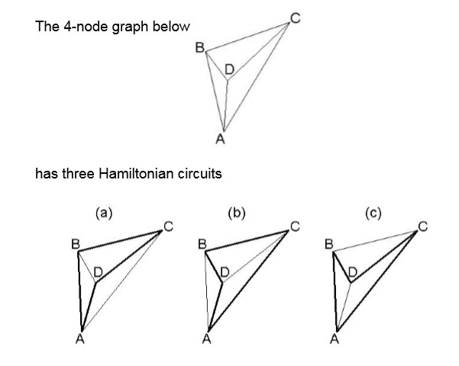
Example

Slide 42
E.g.: Hamiltonian Cycle
hamiltonian
not
hamiltonian

Slide 43
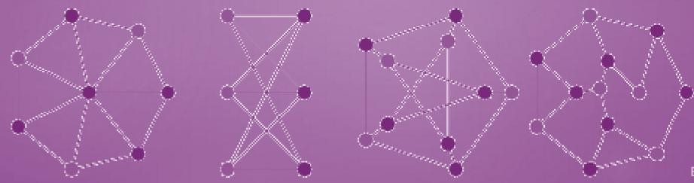
Problem of Independent Sets
 An independent set or stable set is a set of vertices in a graph, no
two of which are adjacent.
 It is a set ’v’ of vertices such that for every two vertices in ’v’,
there is no edge connecting the two.
 Equivalently, each edge in the graph has at most one endpoint in
’v’.
 The size of an independent set is the number of vertices it
contains.

Slide 44
In general
 To prove NP Completeness
○ Prove that the problem can be solved in polynomial time
by non deterministic way
○ Then try to show that the problem can be expressed as
satisfiability problem
○ Now, satisfiability problem is already proven as NP
complete as the 1st problem
○ So given such problem also becomes NP complete
○ Else it is NP hard

Slide 45
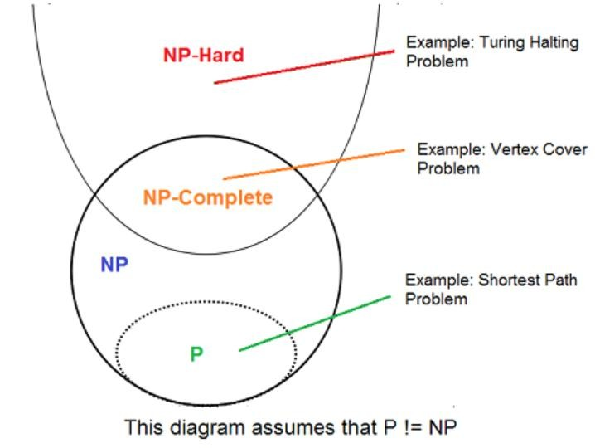
Relation between different classes of problems

